Slide 1
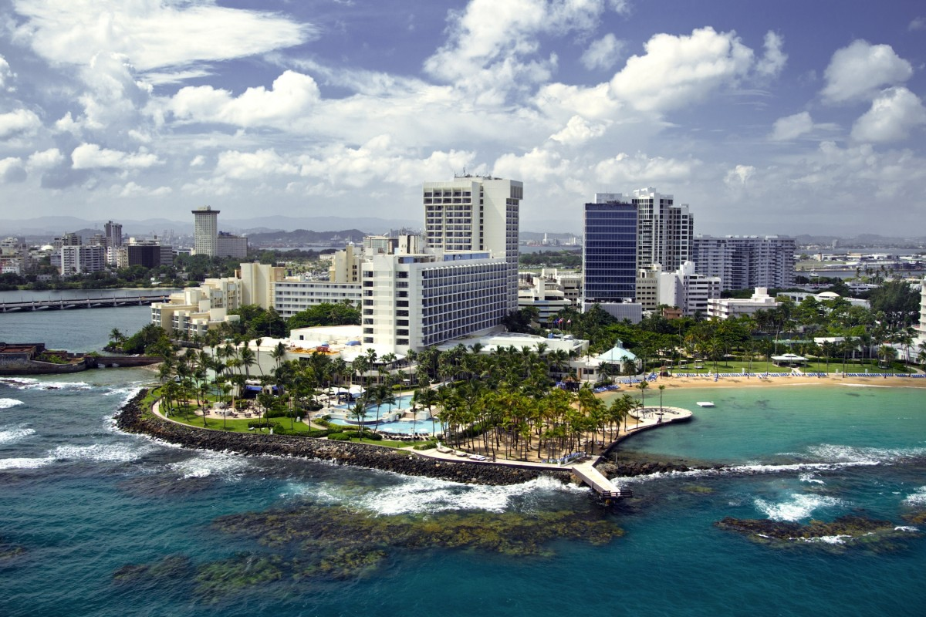
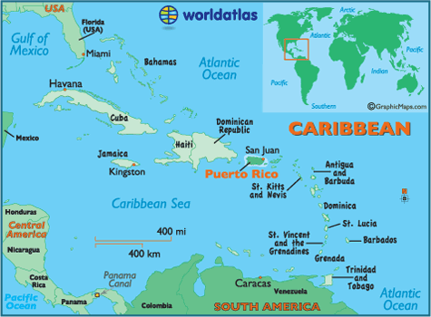
Warm up: Translate- 1. I am smart and funny. 2. She is skinny and ugly. 3. We buy a lot of red clothes. 4. Do ya listen well? 5. Yes, I listen.
La capital es San Juan.

