Slide 1
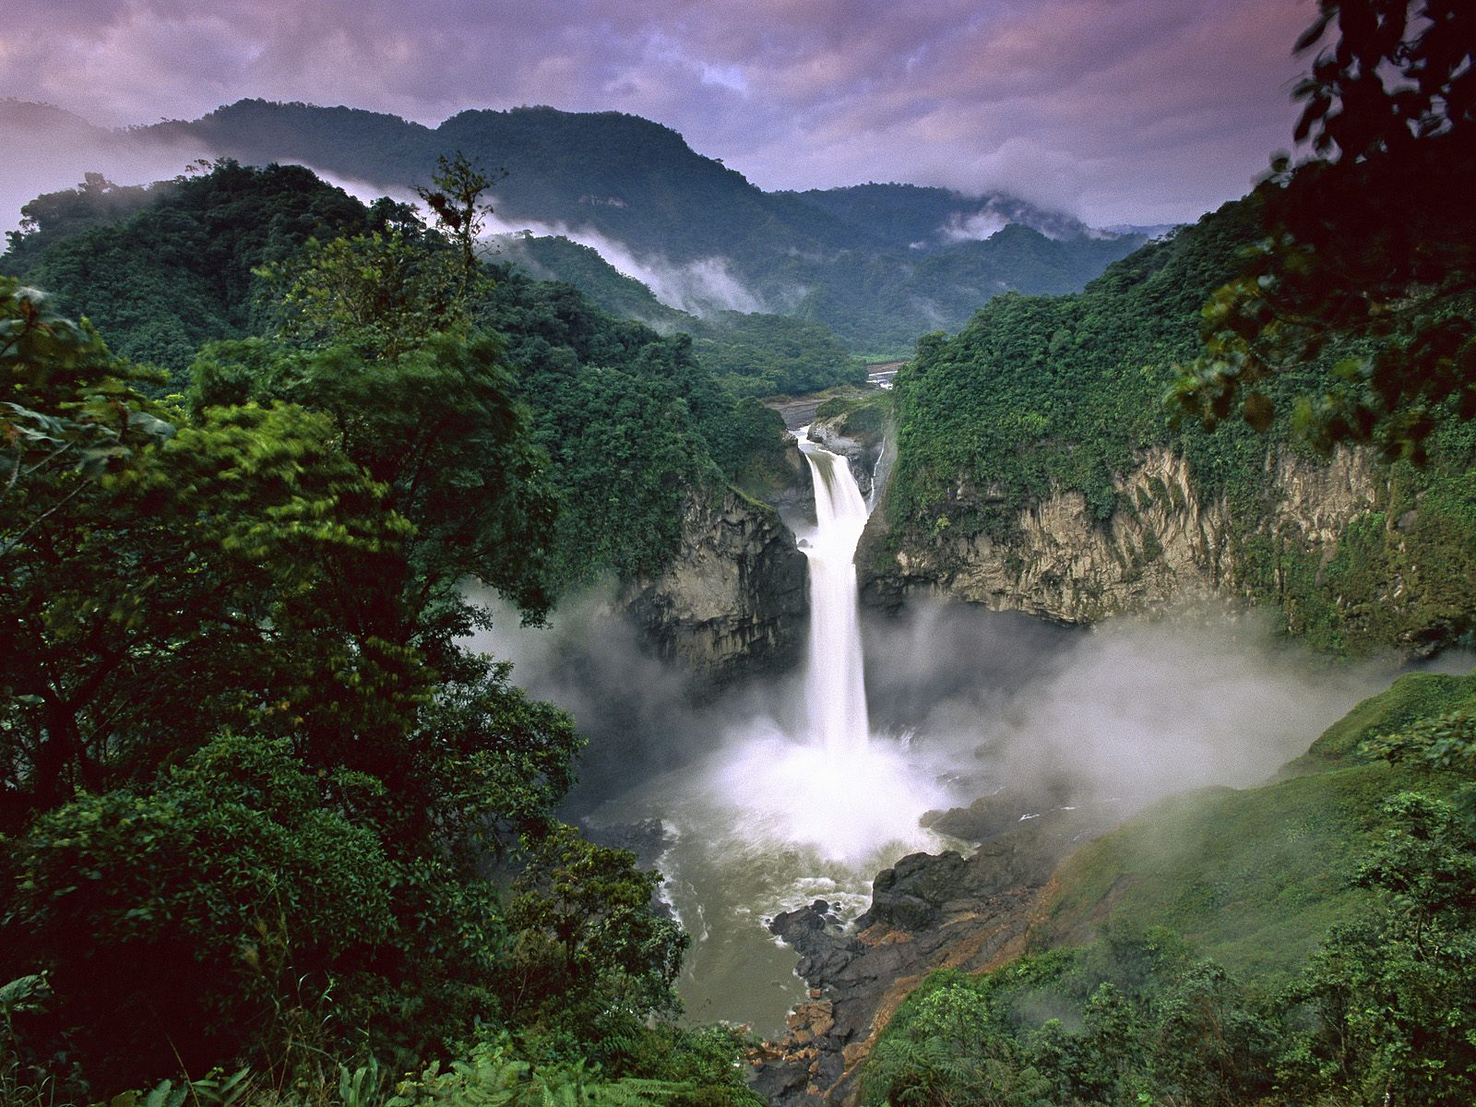
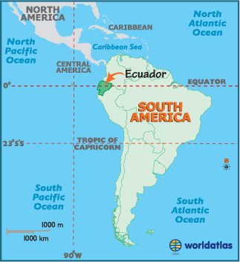
How do you ask what time it is in Spanish? Write the following times in Spanish: 2:05 pm, 6:15 am, 11: 40 pm, 1: 30 am.
La capital es Quito.

